Slide 1
Majlis Ansarullah
Monthly Meeting
March 2017
This slide deck contains images licensed for the purpose of this presentation only.
No one is permitted to use the images for any other use, without prior permission.

Slide 2
AGENDA
Recitation of the Holy Quran (2:139, 6:83)
Pledge
Reminders: Recitation of HQ and Congregational Prayers
Monthly topic: How to prepare ourselves and our families to differentiate between cultural and Islamic values to ward off peer pressure?
Health topic: Living with Diabetes
National Reminders/announcements
Local Reminders/announcements
Dua

Slide 3
It’s a blessing to do Waisyat!
The Promised Messiah (as) said,
“I pray again, for the third time, that O my Mighty and Benevolent! O the Forgiving and the Merciful God! Grant here room for graves to only those who truly believe in this chosen one of Yours, and entertain no hypocrisy, selfish ends or ill-will in themselves; and as faith and obedience rightfully deserve it, they carry out these obligations for Your sake and within their hearts they have sacrificed their lives for Your cause; and with whom You are pleased and about whom You know have been completely consumed in Your love; and who maintain a bond of love and devotion with Your Messenger with loyalty, total respect and manifest satisfaction of Faith. Amen, O Lord of all the worlds.” (Risala Al-Wasiyyat)

Slide 4
Why read the Holy Quran regularly?
Holy Quran teaches the best prayers
Apart from the Holy Quran, what book is there at the very outset which has taught its readers a prayer like ‘Guide us to the right path, the path of those on whom Thou has bestowed Thy blessings’, and has thus held out to them a great hope, namely, the hope of the way being shown to them to the attainment of those blessings which were bestowed on those who were of the Prophets, the Sadiqeen, the Shohada’a, and the Saliheen. Therefore, elevate your resolve, and do not reject this invitation of the Quran when it calls you to work for the attainment of the blessings given to the earlier people.
(Our teachings page 21)

Slide 5
Watching Our Congregational Salat!
Salat Centers
Many Ahmadis living in the Western countries live 15-20 miles from Masjid, but still make the effort to go to Masjid to offer salat in congregation. If everyone who possesses a car utilizes it for worldly matters, uses it for gaining God’s please, then the purpose of these vehicles will become the service of Islam and the individual will gain both worldly and religious rewards. Wherever it is not possible to go to Masjid, a few Ahmadis living close by should organize to get together in one home to offer prayers in congregation. And those Ahmadis living in isolated areas should make arrangements within the household to offer prayers in congregation with family members. The children will also learn the importance of salat in this manner. Such arrangements will also safeguard the children from getting involved in other activities outside the home.
(Friday Sermon of Hadhrat Khalifatul Masih V (aba), June 22, 2012)

Slide 6
How to prepare ourselves and our families to differentiate between cultural and Islamic values to ward off peer pressure?

Slide 7

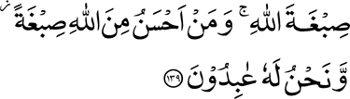
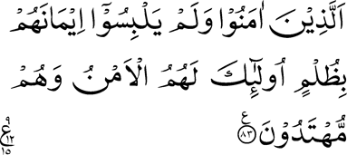
Click to listen the recitation
[2:139] Say, ‘We will adopt the religion of Allah; and who is better than Allah in teaching religion, and Him alone do we worship.’
[6:83] Those who believe and mix not up their belief with injustice — it is they who shall have peace, and who are rightly guided

Slide 8
What do these two verses teach us about the topic i.e., mixing religion with culture or being affected by peer pressure?
Share your thoughts

Slide 9
Guidance from the Promised Messiah (as)
Beware! Having seen other nations, how they have attained a considerable measure of success in their worldly plans, you should not wish to follow in their footsteps. Listen carefully and take heed that they are aliens to and unmindful of that God who calls to all towards Himself. What is their god but a frail human being, this being the reason why they have been left in such a complacent error. I do not wish to stop you for striving for worldly good, but you should not follow the ways of those who think this present world is all in all.
(Our Teachings, page 13)

Slide 10
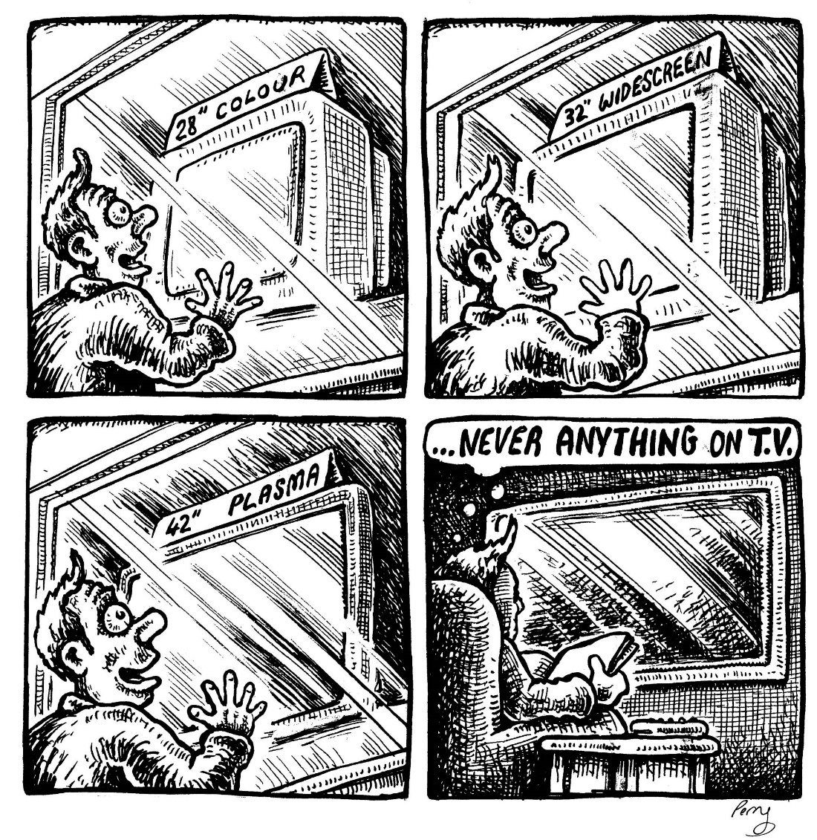
Discussion I
You have just received your income tax refund and your daughter reminds you that the family is due for a new TV. You argue that the TV you have is only three years old and, with the MTA dish, it meets the family’s needs. Your daughter, on the other hand, says there are now 3D, Hi-Definition and Smart TVs that will be compatible with future technologies.

Slide 11
  What’s the best approach?
  Option 1: Tell your daughter to research which TV is best to purchase, which will best serve the future.
  Option 2: Tell your daughter if she really wants a new TV, she’s got to chip-in 50% for it.
  Option 3: Convey to your daughter that the current TV is adequate. There is more blessing if the tax return goes towards one of the Jama’at’s funds.
  Option 4: any other response

Slide 12
Guidance from the Promised Messian (as)
The remarkable material progress of the current age has been more than counterbalanced by its deplorable spiritual decline, to the extent that the souls of men have lost their ability even to grasp obvious truths. It is apparent from a close study of humanity that a hidden and formidable force is pulling it downwards, and man is swiftly being dragged into a pit which is termed Asfalus Safilin (the lowest of the low). Such a complete change has come over the intellects of men that they have come to admire and praise things which are abhorrent and detestable to the spiritual eye. Pure truths are laughed at and ridiculed, and complete submission to God is looked upon as an absurdity.
How to be free from sin, by Promised Messiah (as)

Slide 13
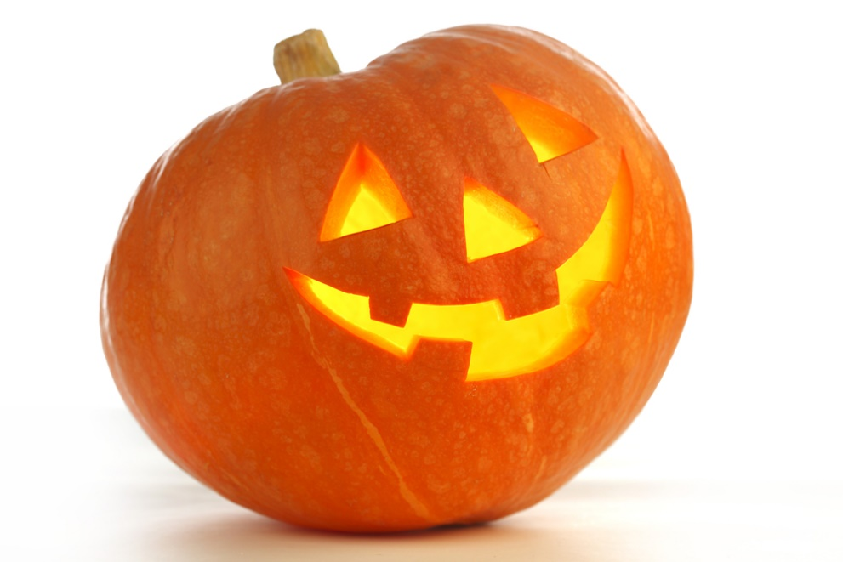
Discussion II
Your daughter’s first grade class is holding a Halloween party during school where all the students are invited to wear costumes. Your daughter innocently asks you if she can dress as one of the Disney princesses for the Halloween party. Her friends are also going as Disney princesses.

Slide 14
  What’s the best approach?
  Option 1: Allow her to participate this year as a princess as she desires.
  Option 2: Have her miss the day of school.
  Option 3: Send her in with normal school attire.
  Option 4: any other response.

Slide 15
Guidance from Huzur (aba)
We are fortunate to belong to the Jama'at of the Promised Messiah (on whom be peace) and traditions which are devoid of any wisdom should not have any impact on us. However, we too are not completely safe. People with different viewpoints enter the Jama'at and some newcomer scholars interpret matters according to their own mind-set. Of course it is not forbidden to do so; however, there are some principles which need to be followed in this regard. In order to avoid promoting any erroneous concept scholars should express their views in subordination of Khilafat. With the grace of God our Jama'at is generally free from such issues but there is need to be constantly aware of this.
Friday Sermon, February 13, 2015 by Hadhrat Khalifatul Masih V (aba)

Slide 16

Discussion III
While shopping with your family at the mall, you run into one of your female co-workers with her husband. She is surprised to see you and immediately rushes up to you to give you an innocent hug and kiss on the cheek.

Slide 17
  What’s the best approach?
  Option 1: Greet her the same way back.
  Option 2: Just shake her hand and hold your arm firm, so that she remains at arm’s length.
  Option 3: Explain to her right then and there that you are not comfortable greeting her in this manner.
  Option 4: Another option?

Slide 18
Guidance from Huzur (aba)
Hadhrat Khalifatul Masih V a.b.a. in a Friday sermon dated October 29, 2010 said,
The Promised Messiah (on whom be peace) wrote in his book ‘Al Wassiyat’ (The Will): ‘God Almighty desires to draw all those who live in various habitations of the world, be it Europe or Asia, and who have virtuous nature, to the Unity of God and unite His servants under one Faith. This indeed is the purpose for which I have been sent to the world. You, too, therefore should pursue this end, but with kindness, moral probity and fervent prayers.’ [The Will, pp. 8 – 9] Hudhur said it is the obligation of Ahmadis that in understanding this message they become helpers of the Imam of the age and endeavour to establish Unity of God with their each word and deed.

Slide 19
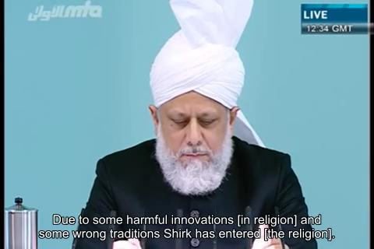
A Short Video from Friday Sermon, Oct. 29, 2010

Slide 20
Translation of the Video
Due to some harmful innovations [in religion] and some wrong traditions Shirk has entered [the religion]. Not only hidden Shirk but also sometimes we can see the obvious Shirk as well. However, according to His promise, Allah Ta’ala has sent the Imam of the age to safeguard Islam from this Shirk and such innovations. And inshAllah, this [Islam] will remain safe. About pointing out these harmful innovations, which have entered in Islam and in Muslims and their wrong traditions, the Promised Messiah (as) says, “our way is exactly the same as that of the Holy Prophet (saw) and his companions. These days, ascetics have introduced many harmful innovations, like Chillas, Wazaifs or Zikrs, which I dislike. The correct way of Islam is to read the Holy Qur’an with deliberation, and act on it, and to offer Salat with reflection and to keep praying from God. Its only the Salat which can take [us] to the status of Mairaj. If you safeguard Salat, then you have everything”. So let alone ordinary harmful innovations, the Promised Messiah (as) even considered involving too much in incantation (wazaif/wird/dikr) as harmful innovation. This is because such practices make one forgetful of the spirit of worship, which is Salat, and Wazaif and Wirds take over.

Slide 21
Where do we stand?
اپنے جائزے لیں
Self analyze yourself, KMV
During the last month
How many times did you give preference to a TV show over Salat?
How many times did you participate in a work ritual not appropriate for an Ahmadi Muslim?
How many times did you participate in a family ritual not appropriate for an Ahmadi family?
Add the three numbers together.
(Keep it to yourself.. the “score” is for you!)

Slide 22
How to Improve?
اپنے اندر پاک تبدیلیاں پیدا کریں
Bring about pious changes in yourself
0-1
Combined Score
>5
Continue to stay strong in not involving yourself in any nonIslamic cultural practices at work or at home
Keep praying and strive to be able to differentiate between Islamic and cultural practices to stay away from them
Pray and strive hard for strength and make an effort not to participate in a non-Islamic ritual at next opportunity

Slide 23

Health Topic: Living well with Diabetes

Slide 24
What is Diabetes Mellitus
Diabetes Mellitus is a metabolic disorder causing abnormal increase in blood sugar
Type 2 diabetes is the most common form and is usually seen in older adults
Type 1 Diabetes is more commonly diagnosed in children and young adults
In Type-2, the body uses insulin inefficiently causing your sugar to rise (Insulin resistance)
Common symptoms of diabetes - Some people may not have significant symptoms at all
  Frequent Urination
  Feeling very thirsty
  Feeling very hungry - Increased appetite
  Weight loss - even though you are eating more (type 1)
  Extreme fatigue
  Blurred vision
  Cuts/bruises that are slow to heal
  Tingling, pain, or numbness in the hands/feet (type 2)

Slide 25
Complications of Diabetes
Skin Complications
Eye Complications
Neuropathy
Foot Complications
Kidney Disease
High Blood Pressure
Stroke
Gastroparesis
Heart Disease
Diabetic ketoacidosis (DKA) mostly in type 1 diabetes
Hyperosmolar Hyperglycemic Nonketotic Syndrome (HHNS)
Mental Health

Slide 26
How do I manage Diabetes?
Choosing what, how Much, and when to eat. You need to make some changes, but you have flexibility with the menu
Being active is the most important part of managing diabetes. Aerobic activity in particular is vital to managing diabetes
Weight Loss will help improve your sugar blood pressure and cholesterol and contribute to overall wellbeing in diabetes
Medicines will to help to keep your blood glucose in your target range
Monitoring blood glucose will help you manage your diet, activity and medicines
Join a support group; www.diabetes.org) is an excellent resource

Slide 27
Four Priorities for 2017
At least 50% of Tajnid to attend monthly meetings where we discuss Huzoor’s vision: “Save yourself and your families from a fire” in interactive discussions.
Bring 350+ new Ansar in Nazam-e-Wasiyat (The targets for small, medium and Large Majlis are 3, 5, and 7, respectively)
Help establish a culture of congregational Salat.
More than 50% Tajnid to attend National Ijtima.

Slide 28
Local Reminders
Dua

